Slide 1

FUNDAMENTALS OF SIX SIGMA
Definition
Different opinions on the definition of six sigma
Six Sigma
As a Measure
As a Benchmark
As a Metric
As a Methodology
Six Sigma Tools

Slide 2
SIX SIGMA DEFINITIONS
A Management driven, scientific methodology for product and process improvement which creates breakthroughs in financial performance and Customer satisfaction.
Source: Motorola
A methodology that provides businesses with the tools to improve the capability of their business processes. This increase in performance and decrease in process variation lead to defect reduction and improvement in profits, employee morale and quality of product.
Source: ASQ

Slide 3
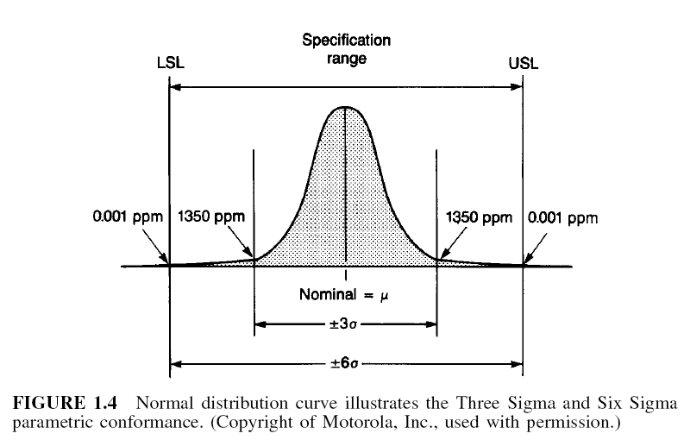
SIX SIGMA DEFINED
In a narrow sense…
A metric based on Statistical Measure called Standard Deviation
In a broader, business sense…
WORLD CLASS QUALITY providing a BETTER product or service, FASTER, and at a LOWER COST than our competitors.
VARIATION… “the enemy of the customer satisfaction”

Slide 4
WHAT IS SIX SIGMA?
DIFFERENT OPINIONS ON THE DEFINITION OF SIX SIGMA:
Six Sigma is a PHILOSOPHY: This perspective views all work as processes that can be defined, measured, analyzed, improved and controlled. Processes require inputs (x) and produce outputs (y). If you control the inputs, you will control the outputs: This is generally expressed as y = f(x).
Six Sigma is a SET OF TOOLS: The Six Sigma expert uses qualitative and quantitative techniques to drive process improvement. A few such tools include statistical process control (SPC), control charts, failure mode and effects analysis and flowcharting.
Six Sigma is a METHODOLOGY: This view of Six Sigma recognizes the underlying and rigorous approach known as DMAIC (define, measure, analyze, improve and control). DMAIC defines the steps a Six Sigma practitioner is expected to follow, starting with identifying the problem and ending with the implementation of long-lasting solutions. While DMAIC is not the only Six Sigma methodology in use, it is certainly the most widely adopted and recognized.
Six Sigma is a METRIC: it uses the measure of sigma, DPMO (Defect Per Million Opportunities), RTY (Rolled Throughput Yield) etc.

Slide 5
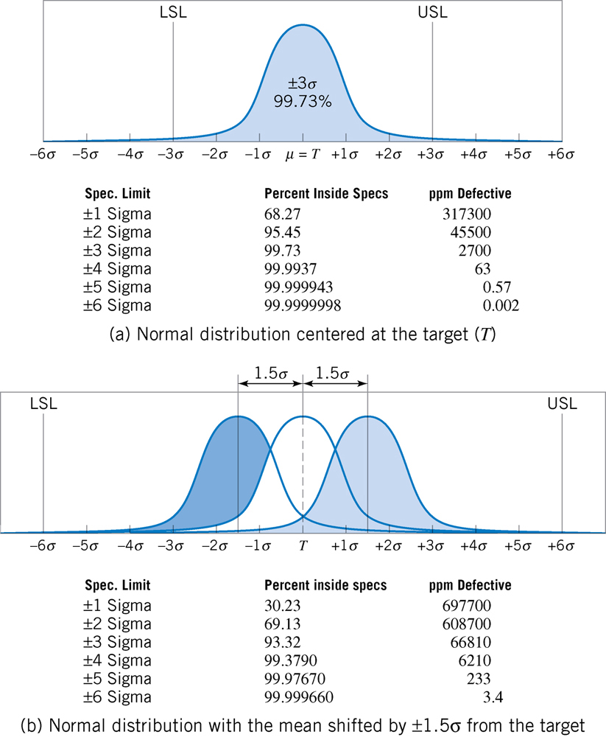
WHAT IS A SIX SIGMA … As a Measure?
1.5 Sigma Shift Theory

Slide 6
WHAT IS A SIX SIGMA … As a Benchmark?
Yield | DPMO | COPQ | SIGMA
99.997% | 3.4 | < 10% | 6
99.976% | 233 | 10 – 15 % | 5
99.4% | 6,210 | 15 – 20 % | 4
93% | 66, 807 | 20 – 30 % | 3
65% | 308, 537 | 30 – 40 % | 2
50% | 500, 000 | > 40 % | 1
Source: Journal for Quality and Participation, Strategy and Planning Analysis

Slide 7
WHAT IS A SIX SIGMA … As a Metric?
Each of these metrics serves a different purpose and may be used at different levels in the organization to express the performance of a process in meeting the organization’s (or customer’s) requirements. We will discuss each in detail as we do through the course.
Defects
Defects Per Unit (DPU)
Parts Per Million (PPM)
Defects Per Million Opportunities (DPMO)
Yield
First Time Yield
Rolled Throughput Yield (RTY)
Sigma(s)

Slide 8
SIX SIGMA: Metric (Cont…)
In any process improvement endeavor, the ultimate objective is to make the process:
Better: DPU, DPMO, RTY (there are others, but they derive from these basic three)
Faster: Cycle Time
Cheaper: COPQ
If you make the process better by eliminating defects you will make it faster.
If you choose to make the process faster, you will have to eliminate defects to be as fast as you can be.
If you make the process better or faster, you will necessarily make it cheaper.
The metrics for all six sigma projects fall into one of these three categories

Slide 9
SIX SIGMA: Metric (Cont…)
Six Sigma methods quantify individual defects and not just defectives
Defects account for all errors on a unit
A unit may have multiple defects
An incorrect invoice may have the wrong amount due and wrong due date
Defectives simply classifies the unit bad
Doesn’t matter how many defects they are
The invoice is wrong, causes are unknown.
A Unit:
is the measure of volume of output from your area.
is observable and countable. It has a discrete start and stop point.
It is an individual measurement and not an average of measurements.

Slide 10

SIX SIGMA: Metrics (Cont…)
DPU (Defects / Unit)
(# of Defects / # of Units)
Say:
10 Defects, 100 Pairs
DPU = 10/100 = 0.1 (10%)
DPO (Defects / Opportunity)
(# of Defects) / (# of Units X # of Defect Opportunities / Unit)
Say:
10 Defects, 100 Pairs,
2 Opportunities / Carton
DPO = 10/(100 X 2) = 0.05 or 5% for each type

Slide 11
SIX SIGMA: Metrics (Cont…)
DPMO (Defects / M. Opportunities)
DPO X 10⁶
Say:
10 Defects, 100 Pairs
2 types of defects
DPMO = 0.05 X 10⁶ = 50,000
Yield =1–DPO =1–0.05 = 95 %
50,000 DPMO = 3.145σ
SIGMA Consult Z–Table
Sigma Level

Slide 12
After calculating yield value multiply with 100 and check the value (of yield percentage)in six sigma table.

Slide 13
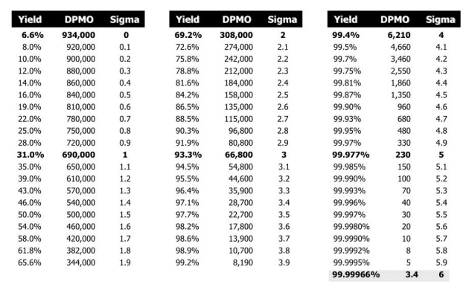

Slide 14
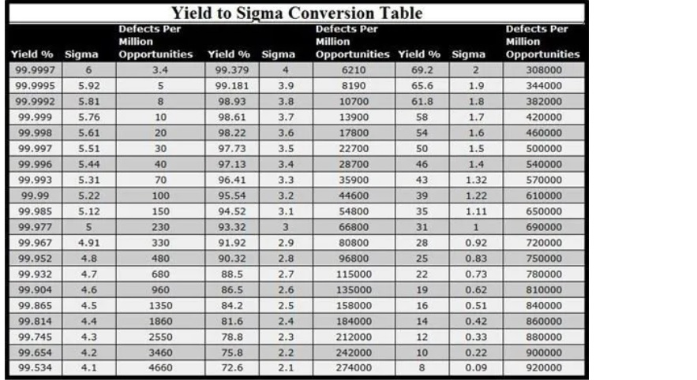

Slide 15

EXAMPLE: Calculate Sigma Value
Calculate the Sigma Value and DPMO of a telecom network had 500 minutes of downtime in 2005.
Product: Network (Connectivity)
CTQ: Up time / Down time
CTQ Measure: Minutes
CTQ Specs: no downtime
Defect measure: One minute of Network down
Opportunity/Unit: 1
Total Defects in 2005: 500 minutes
Total Time (Minutes): 365days X 24hours X 60min. = 525,600
DPU = 500/525,600 = 0.000951
DPO = 500 / (525600 X 1) = 0.000951
DPMO= 0.000951 X 10⁶ = 951
Yield = 1 – DPO = 1 – 0.000951 = 0.999049
SIGMA VALUE = 4.6σ

Slide 16
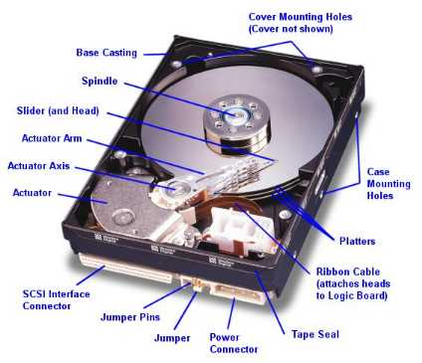
EXAMPLE: Calculate Sigma Value
A manufacturer of computer hard drives wants to measure their Six Sigma level. Over a given period of time, the manufacturer creates 83,934 hard drives. The manufacturer performs 8 individual checks to test quality of the drives. During testing 3,432 are rejected.
# of Defects = 3432
# of Units = 83934
# of Defect Opportunities per Unit = 8
DPU = 3432/83934 = 0.041
DPO = 3432/(83934 X 8) = 0.0051
DPMO= DPO X 10⁶ = 5111
Yield = 1 – DPO = 1 – 0.0051 = 0.9949
SIGMA VALUE = 4.07σ

Slide 17
EXAMPLE: Calculate Sigma Value
A project is focused on a billing process. The team wants to have correct bills sent to the customer. They have defined one opportunity for this process - either the bill is correct or not. All of the bills produced are the same in terms of complexity. The team took a sample of 250 bills and found 60 defects.
# of Defects = 60
# of Units = 250
# of Defect Opportunities per Unit = 1
DPU = 6/250 = 0.24
DPO = 6/(250 X 1) = 0.24
DPMO= DPO X 10⁶ = 240,000
Yield = 1 – DPO = 1 – 0.24 = 0.76
SIGMA VALUE = 2.21σ

Slide 18
EXAMPLE: Calculate Sigma Value
If you have a total of 500 delivery orders and you find out that 41 of those were delivered late, and 17 were incorrect orders.
# of Defects = 41+17 = 58
# of Units = 500
# of Defect Opportunities per Unit = 2
(delivery time and correct order)
DPU = 58/500 = 0.116
DPO = 58/(500 X 2) = 0.058
DPMO= DPO X 10⁶ = 58,000
Yield = 1 – DPO = 1 – 0.058 = 0.942
SIGMA VALUE= 3.07σ

Slide 19
EXAMPLE: Calculate Sigma Value
A telecom service provider complies the defects of one year from the inspection of 100 sites. The severity of each defect is classified in the following:
Critical
Major
Minor
Trivial
The complete checklist comprises of 50 types of defects. The data of 2005 of 100 sites reveals the following figures:
Total # of Critical Defects: 5
Total # of Major Defects: 20
Total # of Minor Defects: 120
Total # of Trivial Defects: 155
Calculate the Sigma Value and the DPMO for the year 2005.
# of Defects = 5 + 20 + 120 + 155 = 300
# of Units (Opportunities) = 100
# of Defect Opportunities per Unit = 50
DPU = 300/100 = 3.0
DPO = 300/(100 X 50) = 0.0600
DPMO= DPO X 10⁶ = 60,000
Yield = 1 – DPO = 1 – 0.0600 = 0.9400
SIGMA VALUE = 3.05σ

Slide 20
SIGMA TABLE
SIGMA LEVEL | SHORT TERM (PROCESS NOT SHIFTED) |  | LONG TERM (PROCESS SHIFTED 1.5 SIGMA)
 | Yield (OK) % | Reject PPM | Yield (OK) % | Reject PPM
1σ | 68.27 | 317,300 | 30.23 | 697,700
2σ | 95.45 | 45,500 | 69.13 | 308,700
3σ | 99.73 | 2,700 | 93.32 | 66,810
4σ | 99.9937 | 63 | 99.3790 | 6,210
5σ | 99.999943 | 0.53 | 99.97670 | 233
6σ | 99.9999998 | 0.002 | 99.999660 | 3.4

Slide 21
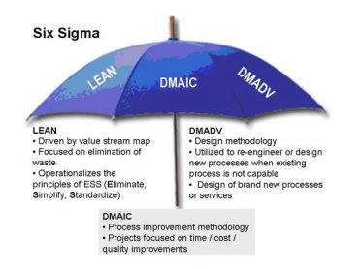
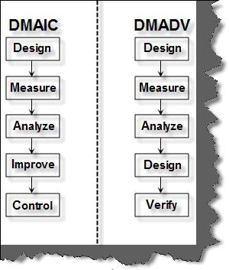
SIX SIGMA METHODOLOGIES
SIX SIGMA & LEAN SIX SIGMA
DESIGN FOR SIX SIGMA

Slide 22
DMAIC: Define
Define the project goals, business justification, & and project outcome
Customers and Critical to Quality (CTQs)
Problem Statement, Goals and Benefits
Identify Champion, Process Owner, and Team
Resources
Evaluate Key Organizational Support
Develop Project Plan and Milestones
Develop Process Map
ACTIVITIES
D1: IPO Diagram
D2: SIPOC Diagram
D3: Flow Diagram
D4: CTQ Tree
D5: Project Charter
TOOLS

Slide 23
DMAIC: Measure
Measure the baseline – determine current performance and long term process capability
Define Defect, Opportunity, Unit and Metrics
Detailed Process Map of Appropriate Areas
Develop Data Collection Plan
Validate the Measurement System Analysis (MSA)
Collect the data and extensive study
Begin Developing Y = f(x) Relationship
Determine Process Capability and Sigma Baseline
ACTIVITIES
M1: Check Sheets
M2: Histograms
M3: Run Charts
M4: Scatter Diagrams
M5: Cause and Effect Diagrams
M6: Pareto Charts
M7: Control Charts
M8: Flow Process Charts
M9: Process Capability Measurement
TOOLS

Slide 24
DMAIC: Analyze
Extensive exercise to carry out root – cause analysis
Define Performance Objectives
Identify Value / Non–Value Added Process Steps
Identify Source of Variation
Determine Root Cause(s)
Determine Vital Few X’s, Y = f(x) Relationship
ACTIVITIES
A1: Process Mapping
A2: Regression Analysis
A3: RU/CS Analysis
A4: SWOT Analysis
A5: PESTLE Analysis
A6: The Five Whys9 involving six questions: Why, What,
Where, When Who and How?)
TOOLS

Slide 25
DMAIC: Improve
Improve the process with experimentations by eliminating defects and re–engineering.
Perform Design of Experiments
Develop Potential Solutions
Define Operating Tolerances of Potential System
Assess Failure Modes of Potential Solutions
Validate Potential Improvement by Pilot Studies
Correct/Re-Evaluate Potential Solution
ACTIVITIES
Mistake Proofing (Poke Yoke)
Design of Experiments (DOE)
House of Quality (Quality Function Deployment)
Failure Mode and Effect Analysis
Simulations
TOOLS

Slide 26
DMAIC: Control
Maintain the Process Capability.
Define and Validate Monitoring and Control System
Develop Standards and Procedures
Implement Statistical Process Control
Determine Process Capability and Cost of Quality
Develop Transfer Plan, Handoff to Process Owner
Verify Benefits, Cost Saving / Avoidance, Profit Growth
Close Project, Finalize Documentation, Reward / Award
ACTIVITIES
Process Sigma Calculation
Control Charts
Cost of Quality Calculations
Control Plan
ISO 9001
Activity Network Diagram
PDCA Cycle
TOOLS

Slide 27
DMAIC Roadmap
Champion / Process Owner
Identify Problem Area
Define
Determine Appropriate Project Focus
Estimate COPQ
Establish Team
Measure
Assess Stability, Capability, & Measurement Systems
Identify & Prioritize all X’s
Analyze
Prove / Disprove Impact X’s Have on Problem
Identify, Prioritize, Select solutions control or eliminate X’s causing problems
Implement Solutions to control or Eliminate X’s causing problems
Improve
Control
Implement Control plan to ensure problem doesn’t return
Verify Financial Impact

